Slide 1

INSTITUTE : UIE
DEPARTMENT : APEX INSTITUTE OF TECHNOLOGY(CSE)
INDUSTRIAL SUMMER TRAINING
ON
WEB DEVELOPMENT
Student Name: Shubham Mahajan
Student UID: 19BCS4275
Section: 19BMC1
Group: A
DISCOVER . LEARN . EMPOWER

Slide 2
Overview
About the Company
Why to choose this Company?
About the Training
What is Web Development?
What is Website and how does it works?
HTML
CSS
Bootstrap
SQL
PHP
About the Project
Scope
Software Required
Project Screenshots
Learning Outcomes
Conclusion

Slide 3

About the Company
Internshala is an internship and online training platform, based in Gurgaon, India.
Founded by Sarvesh Agrawal, an IIT Madras alumnus, in 2010.
Started out as a WordPress blog that aggregated internships across India and articles on education, technology and skill gap.
Internshala launched its online trainings in 2014.
As of 2018, the platform had 3.5 million students and 80,000
companies.

Slide 4
Why to choose this Company?
It has flexible learning system.
The course is available 24x7 and can be accessed offline also.
It has industry relevant trainings.
It has project based learning and industrial experienced faculty

Slide 5
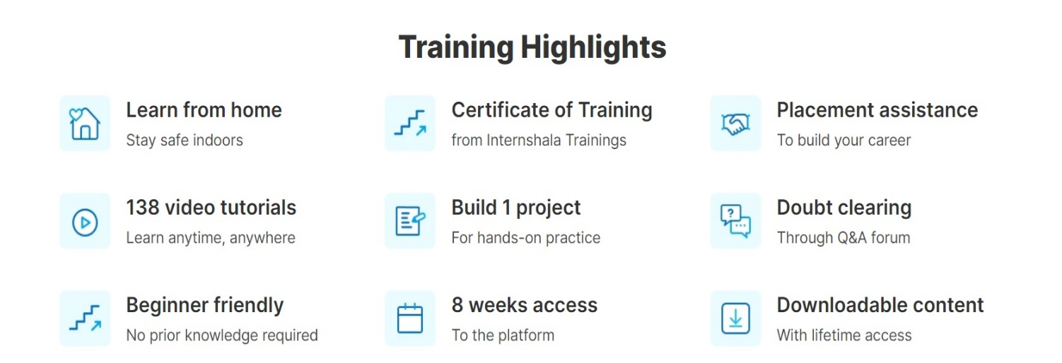
About the Training
Training was done at Internshala.
The Training was done on the topic Web Development.
Training was done through Online Mode.
The Duration of training was 6-8 weeks.
Training was started on 18 June 2021.
Training was ended on 30 July 2021.
Training consists of 1 Project and 4 Assignments.

Slide 6
What is Web Development ?
Web development refers to the building, creating, and maintaining of websites.
It includes aspects such as web design, web publishing, web programming, and database management.
It is the creation of an application that works over the internet i.e. websites.
The word Web Development is made up of two words, that is:
Web: It refers to websites, web pages or anything that works over the internet.
Development: Building the application from scratch.

Slide 7
What is Website and how does it works ?
A Website is a combination of different web pages linked together in a certain fashion according to the designer's will and organizational need served through the same domain name server. Website is typically written in HTML and hosted on single web server for its access through network.
Each website is provided with a unique Uniform Resource Locator (URL) and accessed through the Hypertext Transfer Protocol (HTTP) responsible for making communication possible between client machine and the server by the application of different browsers.
The URLs of the Web Pages are responsible for organizing website into a hierarchy and the hyperlinks between them controls how the reader perceives the overall structure and flow of traffic between the different parts of a website.
Web Development can be typically divided into two classes/Parts:
Front-End Development
Back-End Development

Slide 8
Front-end Development: It is the process of creating the layout of a website. Its the part that the users see and interact with. Its typically coded using HTML/CSS/JavaScript. There are also a few tools and frameworks that can be used, like Bootstrap and Angular.js.
Back-End Development: It is the creation of the functional part of a website. Its what makes the website functional. Another part of the Backend development is interacting with the Database. Some of the most famous Backend languages are PHP/Java/Python/Perl. There are also a few frameworks such as Ruby On Rails/Django/Node.js..

Slide 9

HTML
Stands for Hypertext Markup Language.
It is the standard markup language for documents designed to be displayed in a web browser.
It can be assisted by technologies such as Cascading Style Sheets (CSS) and scripting languages such as JavaScript.
HTML describes the structure of a web page semantically.
With HTML constructs, images and other objects such as interactive forms may be embedded into the page.

Slide 10
CSS
Stands for Cascading Style Sheets.
It is a style sheet language used for describing the presentation of a document written in a markup language like HTML.
CSS is designed to enable the separation of presentation and content, including layout, colors, and fonts.
It Consists of a list of rules. Each rule or rule-set consists of one or more selectors, and a declaration block.
Elements specified by attribute, in particular:
  id: an identifier unique within the document
  class: an identifier that can annotate multiple elements in a document

Slide 11

Bootstrap
It is a free and open-source CSS framework directed at responsive, mobile-first front-end web development
It contains CSS- and (optionally) JavaScript-based design templates for typography, forms, buttons, navigation, and other interface components.
It focuses on simplifying the development of informative web pages.
It provides basic style definitions for all HTML elements.

Slide 12

SQL
SQL stands for Structured Query Language.
It is designed for managing data in a relational database management system (RDBMS).
SQL is a database language, it is used for database creation, deletion, fetching rows, and modifying rows, etc.
SQL is based on relational algebra and tuple relational calculus.
It allows the user to describe and define the data in the database and manipulate it when needed.
It allows the user to create a view, stored procedure, function in a database.
It allows the user to set permission on tables, procedures, and views.

Slide 13

PHP
PHP is an acronym for "PHP: Hypertext Preprocessor“
a general-purpose scripting language that is especially suited to web development.
PHP code is usually processed on a web server by a PHP interpreter implemented as a module.
can be deployed on most web servers on almost every operating system and platform, free of charge.

Slide 14
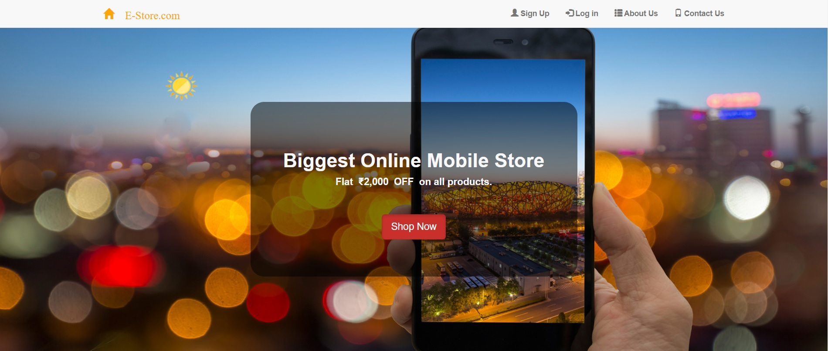
About the Project
In this Project i make a E-Commerce website for a Mobile-Store. The website is consist of HTML, CSS, BOOTSTRAP, SQL and PHP code. The HTML & CSS and BOOTSTRAP part of the code that decides how the website looks, while the PHP and SQL part decides how it functions. The 8 main pages that i have designed for the website are:
index.php
about.php
contact.php
signup.php
home.php
confirm.php
success.php
settings.php

Slide 15
Scope
  Scope of this project is very broad in terms of other manually functioning:
  It can be used by user to get information about the latest smartphones and buy them.
  It can used for corporate world person to sell their products.
  It is based on web application we can easily access it from anywhere.
Software Required
The tools required for this Project are:
Atom Text Editor
XAMPP

Slide 16
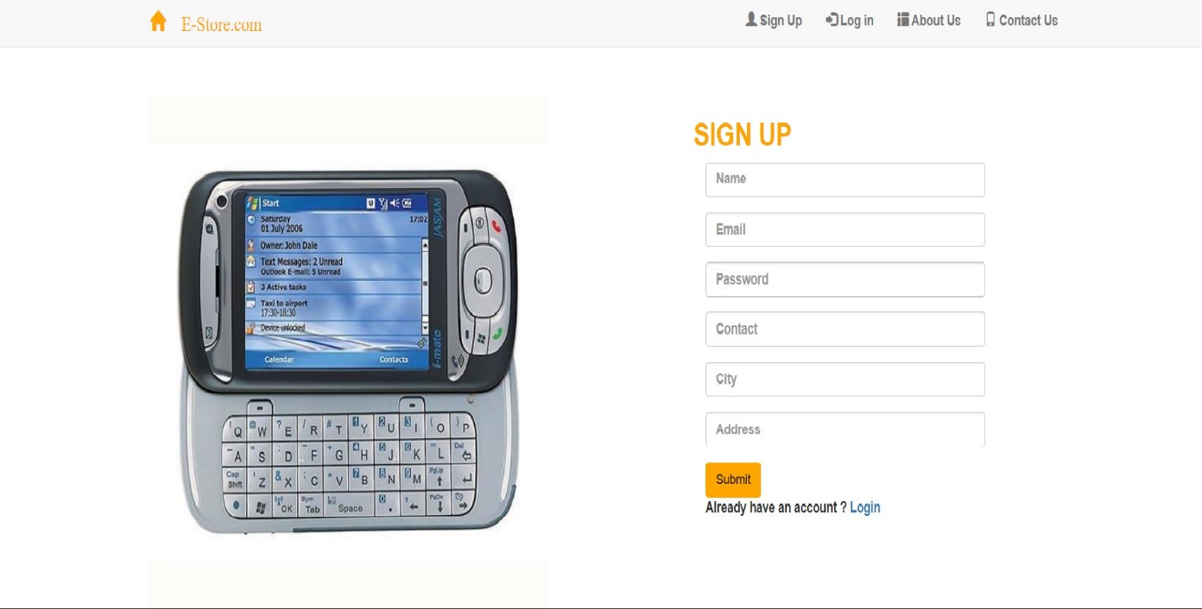
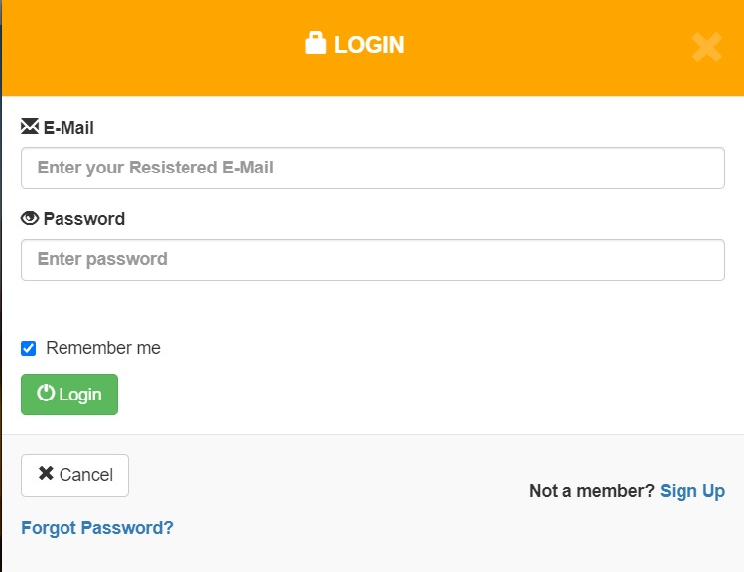
Project Screenshots
Sign Up Page
Login Page

Slide 17
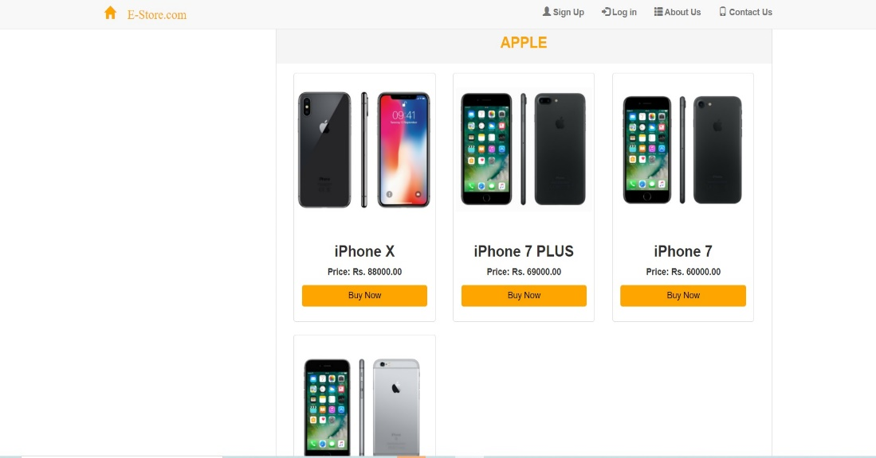
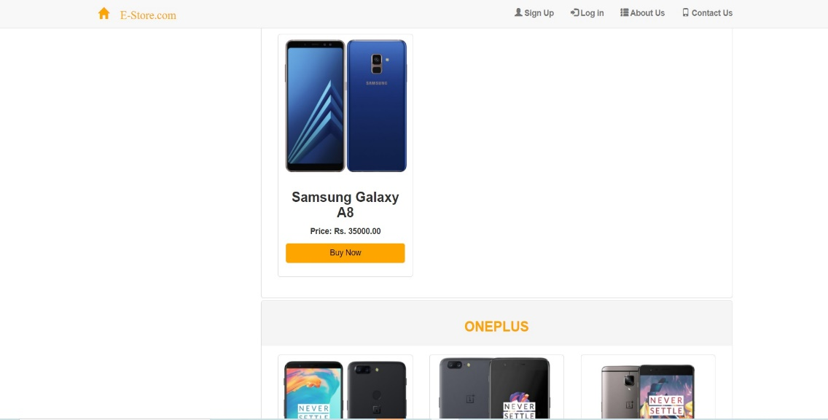
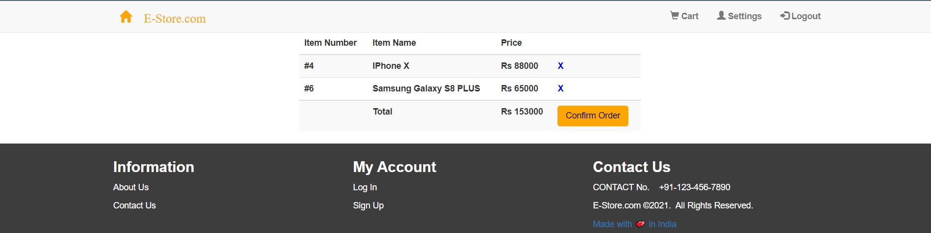
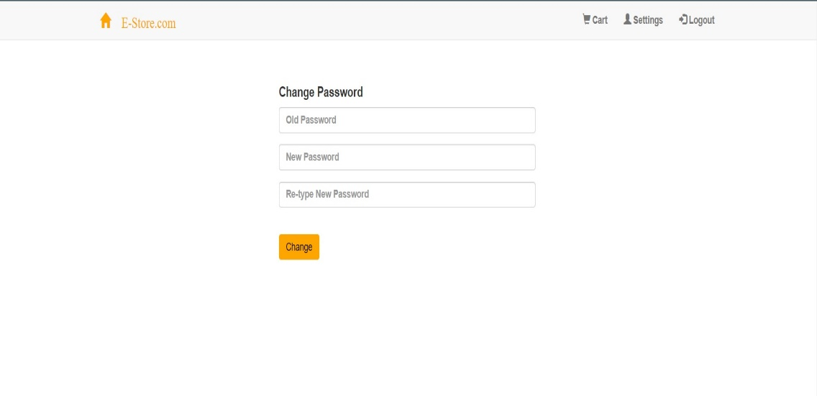
Mobile In Website
Cart Page
Settings to change Password

Slide 18
Learning Outcomes
Learned how to create the website.
Learned how to use the CSS, PHP commands.
Learned how to insert the database in website.
Learnt how to create local database server using XMAPP.
CONCLUSION
A web development project is made that is mobile store website using different techniques like HTML & CSS, Bootstrap, etc.
These skills were learnt and implemented.

Slide 19

THANK YOU

